Slide 2
Agenda
Ignite presentation: Engaging Young Professionals (5 min)
Activity Reports, presented by the Chapter Chairs or Delegates (2-3 slides, <3 min)
Overview: Officers handbook
Overview: Chapter Officer Duties and Center for Leadership Excellence
Overview: Understanding the Chapter Rebate
Overview: IEEE vTools (hands-on SAMIEEE)
Overview: Wordpress – Chapter Website
What’s new with the EMC Society?
Brainstorming: Membership Development (see another ppt)

Slide 3
Ignite Presentation
What’s an Ignite Presentation?
Ignite is a series of speedy presentations
Presenters get 20 slides, which automatically advance every 15 seconds. The result is a fast and fun presentation which lasts just 5 minutes, forcing speakers to get the point, fast. It's the presentation equivalent of a haiku or sonnet.
Ignite events are held in cities around the world.
For more information on Ignite Talks, go to: http://www.ignitetalks.io/
Presented by Caroline Chan caroline.chan.us@ieee.org

Slide 4
EMC Chapter Activity Report Short Summary
Benelux: Collaborate with Dutch EMC-ESD Society
Region9: membership dropping from 50 to 25. Need Help but 55 attendees at a 4 hour workshop
Chicago: lots of volunteers and have a social at the end of the year, successful mini symposium with very low registration fees.
Germany: Bootcamp 2 days with Students and Young Engineers
Italy: outreach to High School (start when they are young!)
Montreal: 2 meetings per year because that’s all its members want
Ottawa: hosted 2016 IEEE EMC International Symposium
Phoenix: lots of attendees 40+, different venues for meetings such as local labs visit and companies
River Rock Valley: very active and hold 1 formal seminar/year
Santa Clara: be pro-active finding speakers to fill up the calendar

Slide 5
EMC Chapter Activity Report Short Summary
Singapore: activities have decreased due to fatigue of the volunteers but still a decent attendees and enough financial support to operate independently
Taiwan: lots of workshop, easily over 300 attendees. Hosted APEMC 2015
Tokyo: Collaboration with EMCJ, IEICE (next symposium is June 3-7 2017)
UK and Ireland: half a day technical talks at different venues such as in the museum or in the universities
Washington DC/Northern Virginia: joint meetings with cross over interest with other local chapters
West Michigan: mini symposium about 50 attendees, good team of volunteers

Slide 6
Officer Handbook
In general, most of the documents on IEEE Chapters can be found at the following link:
http://www.ieee.org/societies_communities/geo_activities/chapters/index.html
*** The IEEE chapter chair reference guide is available on the IEEE website too.
You can get it just using “IEEE chapter chair reference guide” as search key:
http://www.ieee.org/documents/47291_ccrefguide.pdf
*** Similarly, the EMC society Chapter officers' handbook can be find by google by
searching: “EMC society Chapter officers' handbook”
http://www.emcs.org/pdf/Handbook_November_2009.pdf
IEEE EMC Society Website
http://www.emcs.org/chapters_main.html

Slide 7
Chapter Officer Duties and Center For Leadership Excellence
Main Core Chapter Officer Duties (your chapter could have other positions and more elaborate duties than the ones called out below):
Chair: Ensure the chapter is well maintained, look for speakers and provide information to the secretary so he/she can publicize. Solicit for Chapter Officer nominations and setup the Voting tools via vTools. Report the newly elected chapter officers on IEEE and send an email to the Chapter Coordinator.
Treasurer: Manage the Chapter Finance and fill out the L50 financial report required by IEEE by the end of the Calendar Year.
Maintain the dedicated IEEE Concentration Bank for your chapter when possible.
Secretary: Record minutes from ADCOM (Chapter officer meetings), Publicize the upcoming speakers, Maintain the #members vs guests at each of the Chapter meeting and update mailing list. Fill out the L31 report by the end of the calendar year.
Webmaster: Maintain the Chapter Website and make Chapter and relevant Society announcements.

Slide 8
Chapter Officer Duties and Center Leadership Excellence
There are many more short training videos about IEEE that can be found here:
https://ieee-elearning.org/CLE/course/index.php

Slide 9
Chapter Officer Duties and Center Leadership Excellence
There are many more short training videos about IEEE that can be found here (Borrowed from SEM):
http://sites.ieee.org/sem/about-sem/training/

Slide 10
Chapter Rebate and how to get more $$$
Website: http://www.ieee.org/societies_communities/geo_activities/required_reporting/rebate_schedule.html
A- Chapter rebate: US$200 for each chapter and MUST MEET minimum requirement (see below) by doing the L50 (filled by the Chapter Treasurer). Contact your section on how to do L50 https://www.ieee.org/societies_communities/geo_activities/required_reporting/financial_reporting.html
Bonus for timeliness: All sections whose reporting (financial, meeting, and officer) is submitted by the third Friday in February 2016 (exact date might change, verify with your section), will receive a 10% bonus of the total rebate.
Activity bonus: In an effort to encourage activities at the local level, activity bonuses may be awarded as follows:
- All chapters or affinity groups reporting six or more meetings shall receive an additional US$75; in the case of a chapter, at least six of the reported meetings shall be in the technical category. To be filled by the Chapter Secretary in L31 meeting reports https://meetings.vtools.ieee.org/main
Section gets: Membership rebate: US$3 for each member, Graduate Student member, Student, or Associate grade member, US$1.50 for each Affiliate, and US$4 for each Senior or Fellow grade member, based on 31 December 2015 statistics.

Slide 11
Get more $$$
B- Angel Funds $600/year to chapter in financial need. Refer to http://www.emcs.org/chapters/haislmaier.html
C – Chapter Awards: http://www.emcs.org/awards_main.html
Chapter-of-the-Year Award ($250)
Most Improved Chapter Award ($250)
Chapter Founder Award (No monetary fund but recognition)
Tip: start organizing the year before to hit your goal
D- Fundraising/mini symposium: contact Janet O’Neil (j.n.oneil@ieee.org) for any advice on how to organize.
Tip: make it annual to keep consistency, else hard to restart. Organize a technical talk + vendors/exhibit

Slide 12
How to Use vTools
Website: http://sites.ieee.org/vtools/ and also the CLE Training Courses
vTools:
Schedule a meeting
Enter the meeting data (Guest/Non member) L31 (MUST enter ALL by end of the year for ALL chapters)
Chapter officer voting
Chapter officer reporting (MUST do once the election is done)
Create a Survey
Create e-Notice
Financial Report L50 must be reported EACH YEAR to be eligible for the chapter rebate (see Chapter Rebate section)

Slide 13
How to Use SAMIEEE
Tutorial borrowed from R10: http://ewh.ieee.org/ieee/apo/Region10/MembershipPresentations/3.%20SAMIEEE%20Training%20Module.pdf
OR to get the name and email of your members, follow the screen shots after login

Slide 14
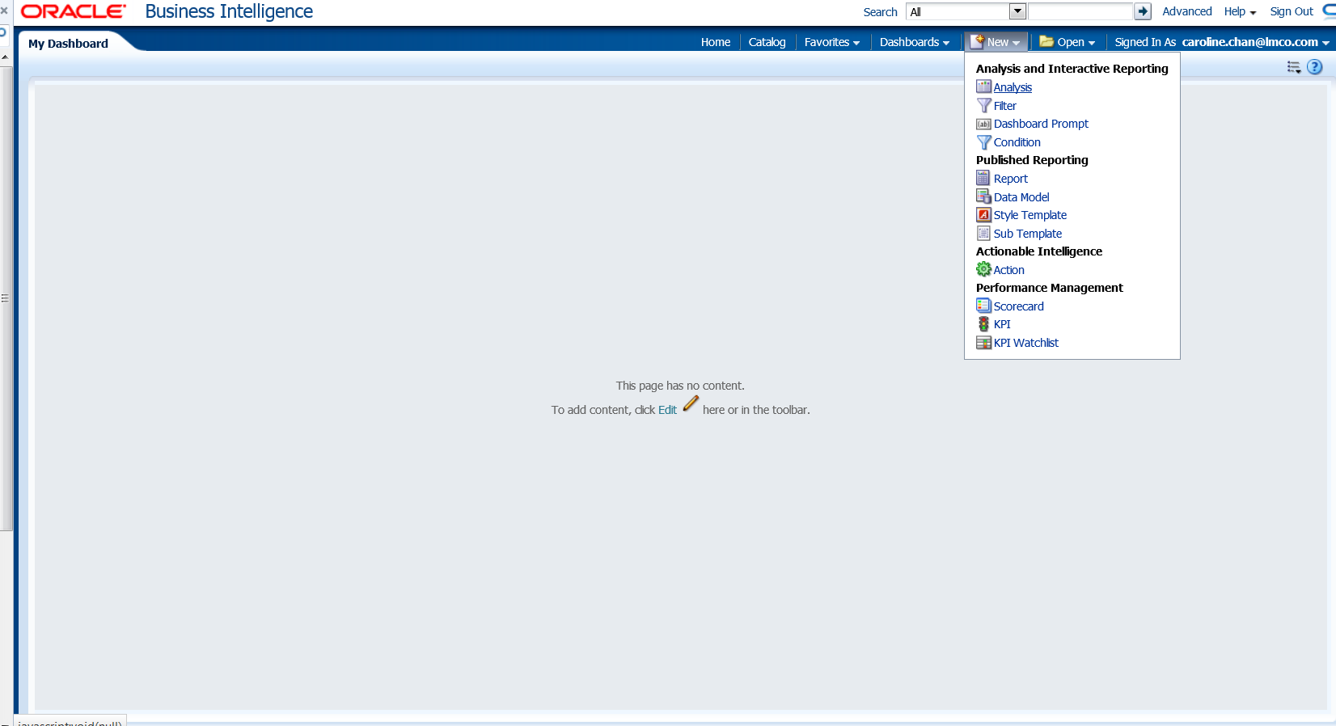
How to Use SAMIEEE
SAMIEEE: how to get the name and email from your chapter: New-> Analysis-> SAMIEEE for Volunteers

Slide 15
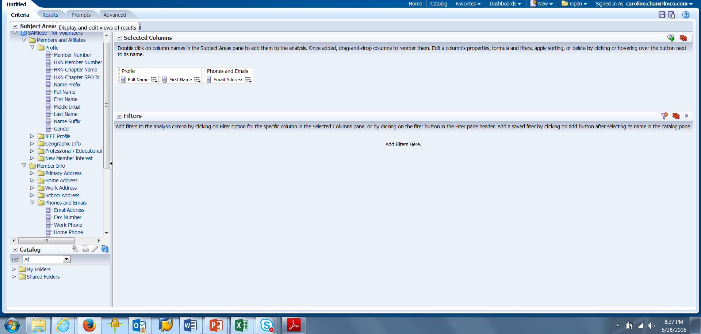
How to Use SAMIEEE
Profile->First, Last (Drop on the right screen)
Member Info-> phone Email (Drop on the right) => Click on the TAB RESULTS

Slide 16
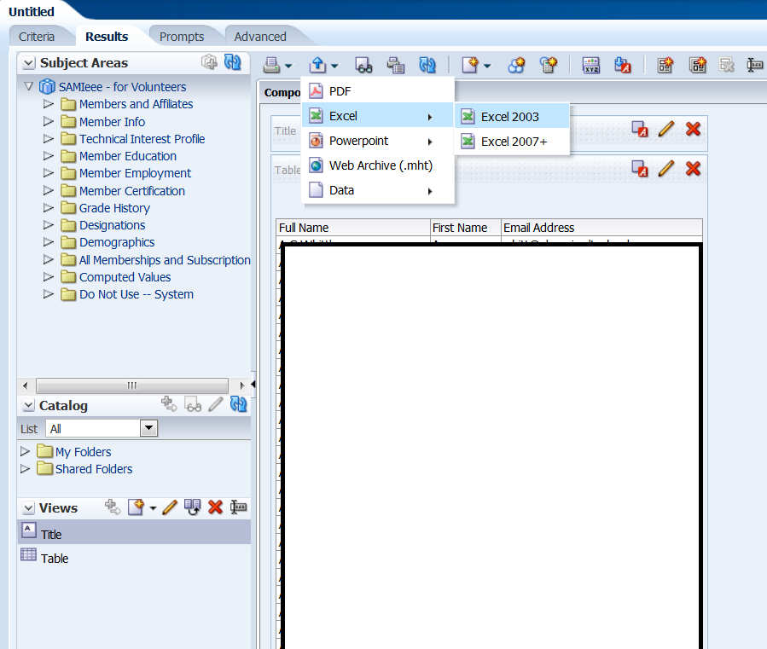
How to Use SAMIEEE
Click on the symbol with Arrow Up to Export.
To understand what each field of the SAMIEEE means, click on this excel document (exacel will merge cells people with the same first name and hard to copy/paste. Instead use .CSV file) OR Data-> .CSV

Slide 17
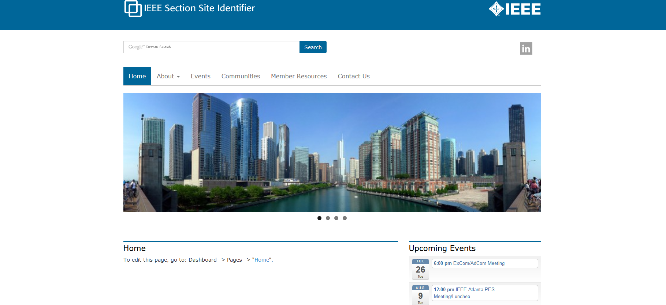
Wordpress (1 of 4)
Template and Host:
Based on IEEE Template, no programming experience necessary
This is what the template will look like: http://sites.ieee.org/section-template/
Request the template and for IEEE host: http://sites.ieee.org/hosting/wordpress-hosting/
(you can add other users later once you become the Admin)
If you haven't heard from IEEE within a week, please contact Khanh Luu k.n.luu@ieee.org
Khanh is the Sr. Information Management Analyst of the IEEE Member and Geographic Activities
Department (MGA)

Slide 18
Wordpress (2 of 4)
Officers updates on Wordpress:
Once the website is up (with login):
http://sites.ieee.org/wnv-emcs/about-ieee/executive-committee/
and
http://sites.ieee.org/wnv-emcs/communities/
are automatically updated for you. To update the officer information use http://officers.vtools.ieee.org/.
To update the communities page, please contact Khanh Luu k.n.luu@ieee.org
Website Updates:
Once you have the login, make the updates by doing to
dashboard-> pages-> select the page you want to edit->type the
information and click on UPDATE (not preview since the "preview" function is not working).
Luckily if you do not like what you just updated, you can always choose the previous revision and go back
to it.

Slide 19
Wordpress (3 of 4)
Meeting calendar updates:
Note that for the calendar, you can go get your URL meeting from the L31
https://meetings.vtools.ieee.org/main
(go to "schedule meeting) to update the RSS feeds. Please take a look on the documents provided in the
Ppt attachment for Wordpress Feeds for step by step instruction. It is easier for the chapter to set and
also a push for the chapter to input their incoming meeting early and hopefully complete the L31 early also.
You can change the "IEEE section identifier" (left corner) by going here
(and you can put the EMC society logo or add your own chapter one) once you have the login and change
the highlight part
of the link to your particular chapter website link (replace “wnv-emcs” with your chapter name) http://sites.ieee.org/wnv-emcs/wp-admin/customize.php?return=%2Fwnv-emcs%2
Fwp-admin%2F&autofocus%5Bcontrol%5D=header_image

Slide 20
Wordpress (4 of 4)
Download IEEE Sites theme tutorial file at
https://drive.google.com/open?id=0B_i1MnQg-aYveXFtODFheFhXR1k&authuser=0.
You also check out the WordPress tutorials presented by Lance McBride and Ed Perkins at:
Session 1 – Fundamentals – Basic WordPress interface and structure, Templates, Calendar
http://research.microsoft.com/apps/video/default.aspx?id=242111
Session 2 – Intermediate - Metatags, Plugins, vTools Calendar, Forms, Surveys,
Promo Images, Redirections, ecommerce)
http://research.microsoft.com/apps/video/default.aspx?id=242109

Slide 21
What’s new with the EMC Society
IoT participation along with other IEEE Societies (collaboration/have a stake): in Review.
IEEE Joint Journal: Prof. Qing Huo Liu of Duke University is the editor in chief of the new APS/EMC/MTTS Joint IEEE Journal on Multiscale and Multiphysics Computational Techniques. A call for papers has been published in 2015. This requires a membership fee besides the EMC membership.
A Practical Paper Journal is being discussed as a separate electronic only and/or print publication. This would include application oriented papers or papers presenting case-studies.
Calling for Participation into the TCs: (Technical Committees) and PACE-IEEE USA (Professional Activities Committees for Engineer BUT it is not just about USA). For more PACE information, contact Kimball Williams (k.Williams@ieee.org) https://www.ieeeusa.org/volunteers/pace/
Student Liaison (Starting Term: now): Joseph Vas (Bangalore) j.v.vas@ieee.org
Young Professionals (Starting Term 2017): Al Frye allanfrye5@gmail.com

Slide 22
Questions?
Contact Caroline Chan, IEEE EMC-S Chapter Coordinator or your Angels
caroline.chan.us@ieee.org
Each Chapter has an Angel. Please get familiar with who your Angel is.
http://www.emcs.org/chapters_main.html -> Chapter Angel List (To be updated for 2016)

